Slide 1
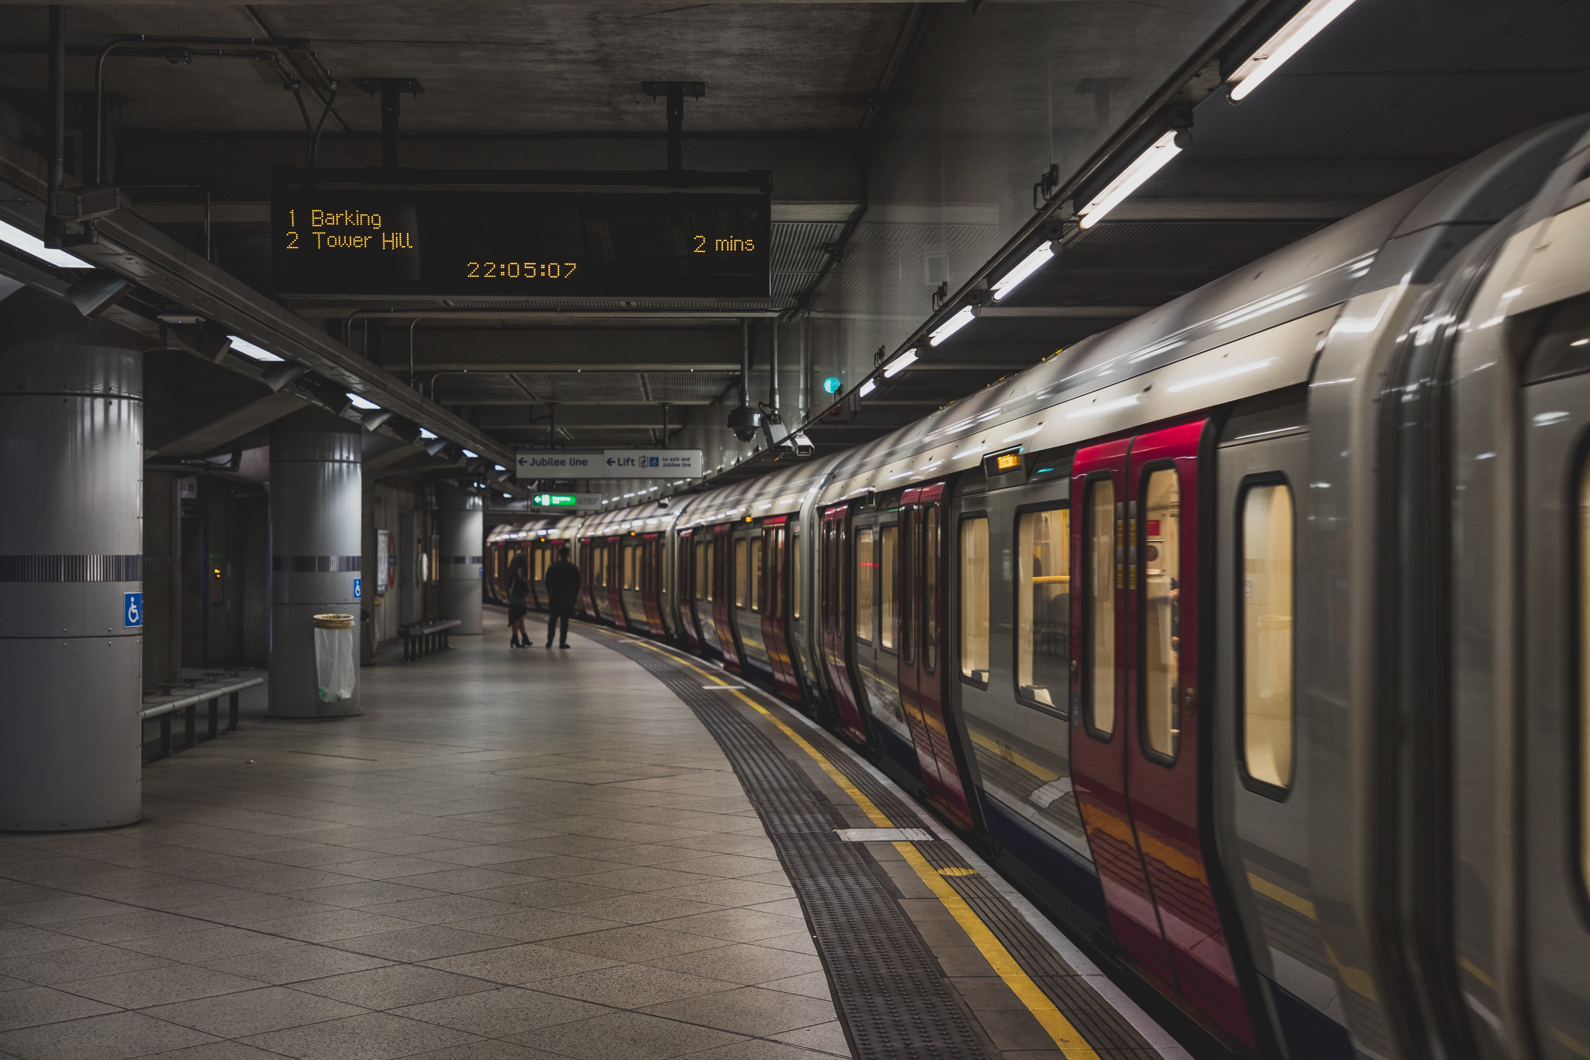
MTA Traffic Analysis for WTWY
Presented by: Mert, Yiğitcan, Osman, Süleyman, Büşra
As Project 1 of
ISTDATA Data Science Bootcamp

Slide 2
Outline
Introduction
Methodology
Data Preparation
Results
Conclusion
Future Work

Slide 3
Introduction
Problem: Inviting as many guests as possible for the WTWY premiere
Solution: Apply data analytics on the MTA subway data on traffic flow to optimize placement of street teams to maximize engagements.

Slide 4
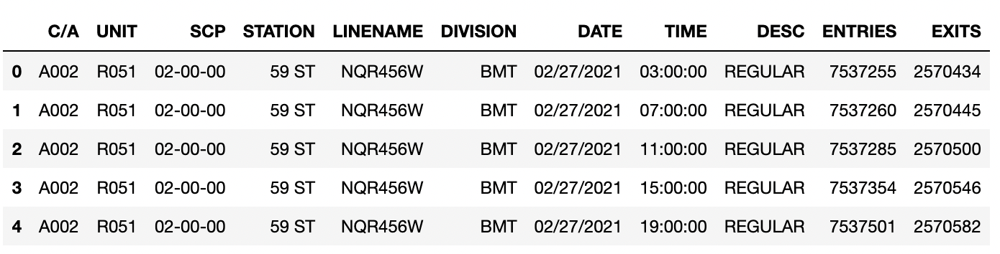
Methodology
Exploratory Data Analysis
Between 27 February 2021 and 24 September 2021 (7 months)

Slide 5
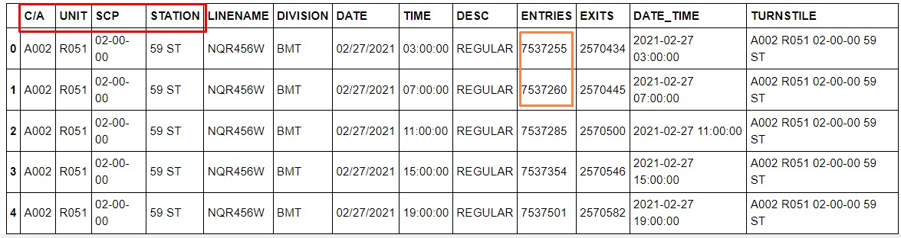
Methodology
Each turnstile has a unique combination of ‘UNIT’ , ‘SCP’, ‘C/A’ and ‘STATION’ number.
Entries and exits increase cumulatively.

Slide 6
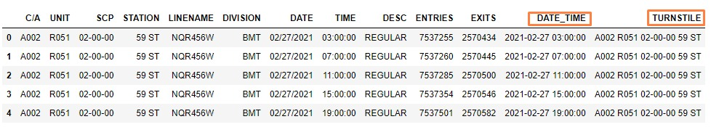
Data Preparation
We concatanated the 'DATE' and 'TIME' columns to 'DATE_TIME' column

Slide 7
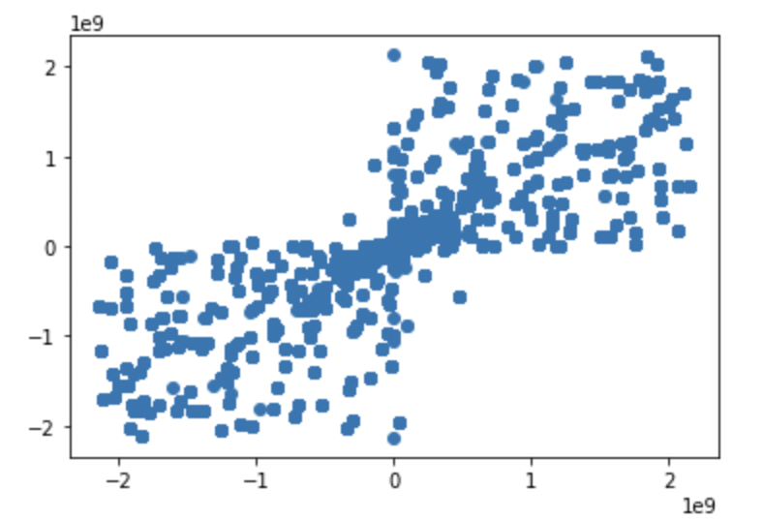
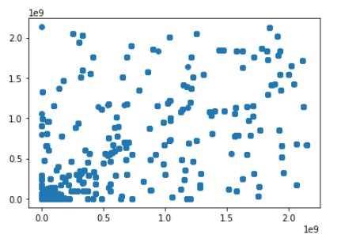
Data Preparation
Notes:
Sıfırdan küçükleri medyana eşitledik. Büyükler aynı kaldı.

Slide 8
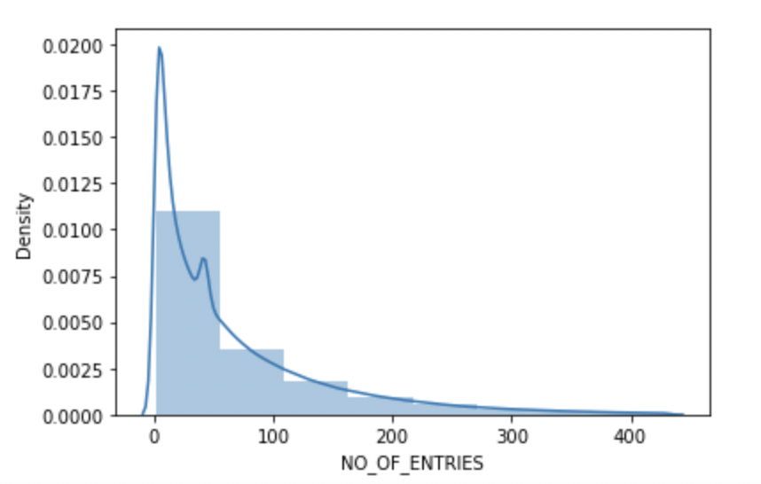
Data Preparation
We decided to give a median to greater values than %98 quantile for eliminating outliers.
Graphic is right skewed that means most of the values in between 300-400.
Notes:
İstasyona her giriş çıkışlarda elde edilen farklı sayıları Outliersleri ayırmak için %98 sola yatık olan

Slide 9
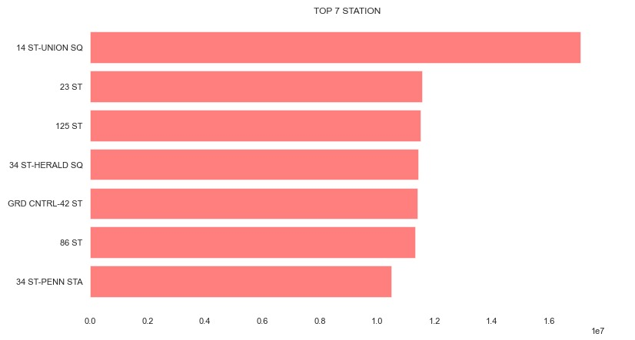
Results

Slide 10
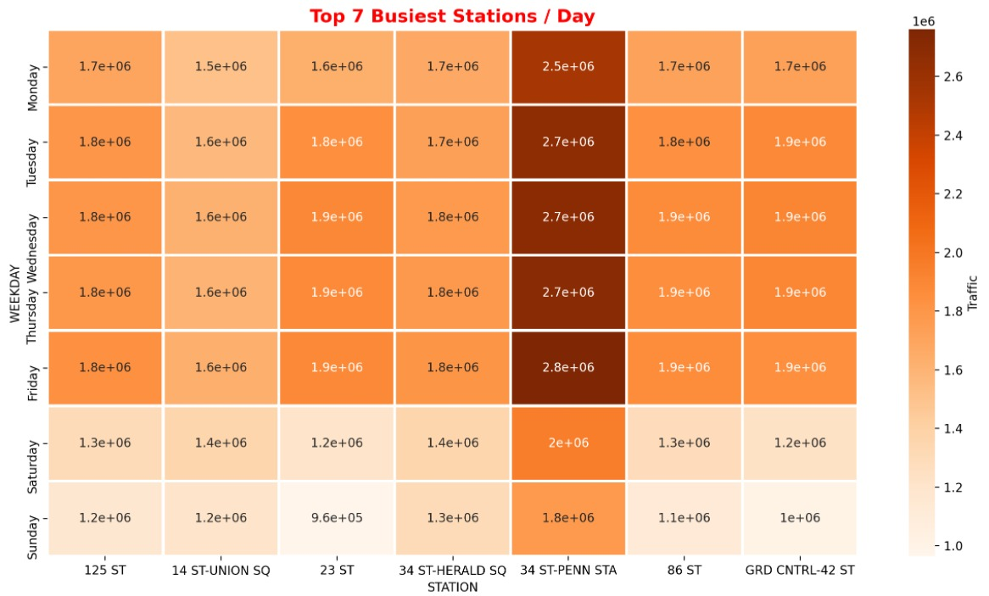
Results

Slide 11
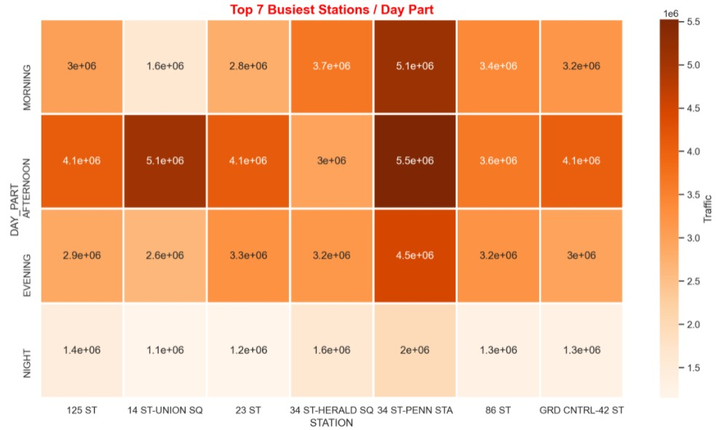
Results
Distribution of traffic across the day part.

Slide 12
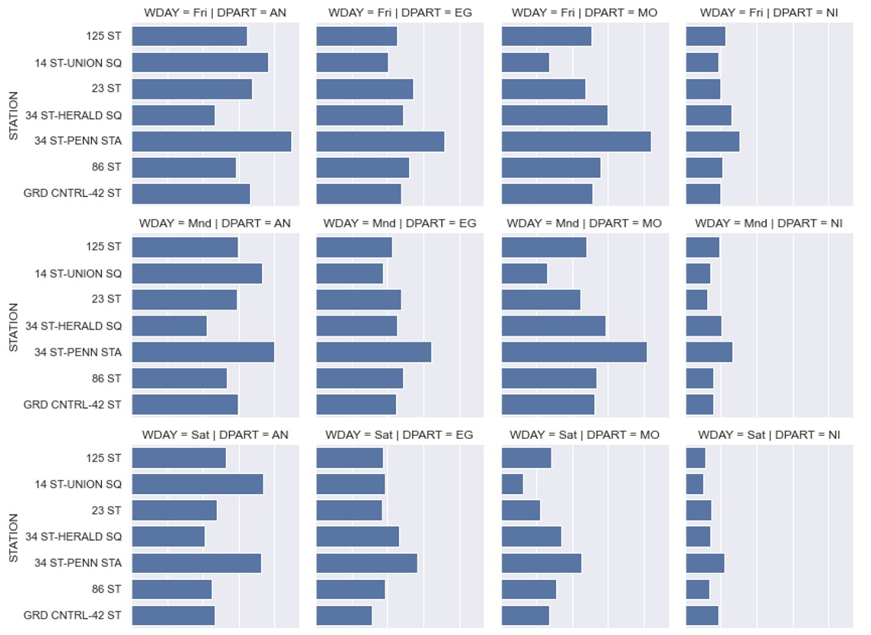
Results

Slide 13
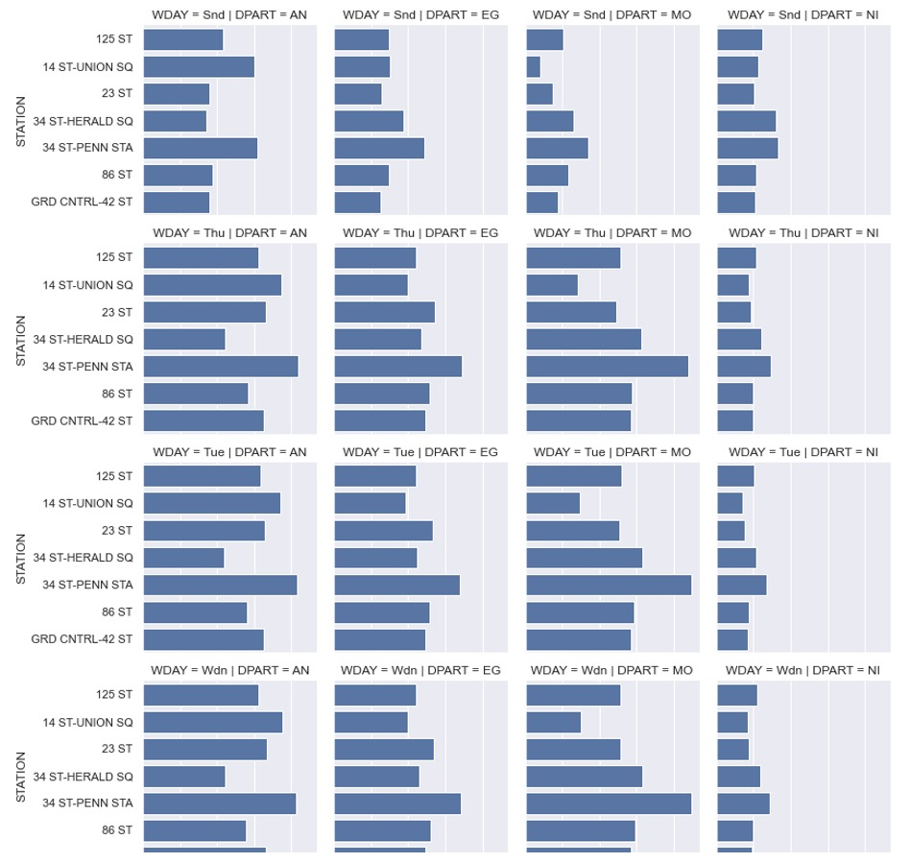
Results

Slide 14
Conclusion
We would advise for WTWY to initialise in the following station is ’34 St Herald SQ Station’
Usually the busiest times are weekdays.
Morning and afternoon time traffic density is more than other times
From our analysis, we can conclude that WTWY should focus top 7 stations, ideally during weekdays in the afternoon and morning periods.

Slide 15
Future Work
Lokasyonlar işaretlenip hangi bölgelerde yoğunluk olduğu bulunabilir
Corona öncesi verilerle şu anki veriler karşılaştırma yapılıp coronanın etkisi bulunabilir. (this project can be extended further by compare to before corana mta data)
İleride yapılacak satış, reklam, pazarlama vs çalışmaları için kalabalık bölgeler bulunduğundan bu sonuçlar kullanılabilir.
By integrating socail,economical factors and wighting their importance, may give a more rounded analysis alongside the MTA data.

Slide 16
Thank You!

